Slide 1
CREDIT SCORING MODEL
Regression Graded Assignment in SAS
By Subhranil Roy

Slide 2
We need to predict who are the bad customer
* In data set we have a column NPA_Status which mean
“More than 180days delinquent”.
Definitely the customer who have more than 180 days delinquent are bad customers which denoted by “1” in NPA_Status.
Here as we dealing with discrete variables like 1/0 in NPA_status which is our dependent variable so we will built a logistic regression model.
Here we will build a credit scoring model to predict the bad customer.

Slide 3
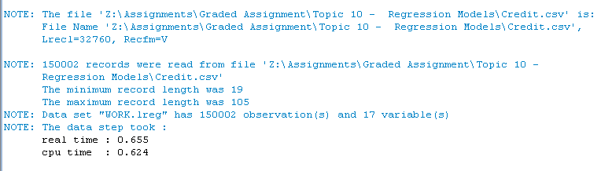
Importing dataset into SAS
/* Import the file */
Proc import datafile="Z:\Assignments\Graded Assignment\Topic 10 - Regression Models\Credit.csv“
Out=Credit2.lreg dbms=csv replace;
run;
Log file shows that dataset has total 150002 observations and 17 variables.

Slide 4
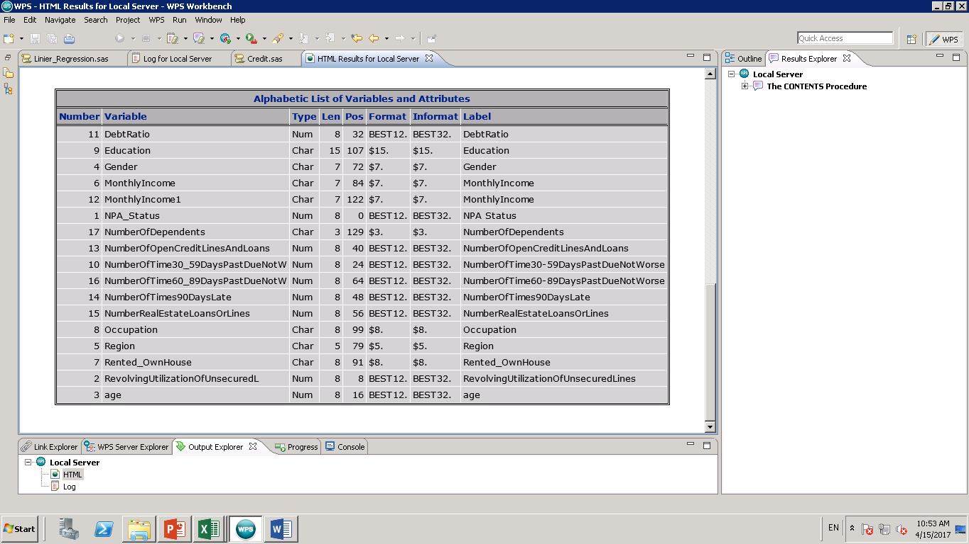
Checking the contains of the dataset
proc contents data=Credit2.test;
run;

Slide 5
Converting Monthly-Income to numeric
data Credit2.test;
set Credit2.lreg;
new_monthly_income=input(Monthlyincome,best12.);
run;

Slide 6
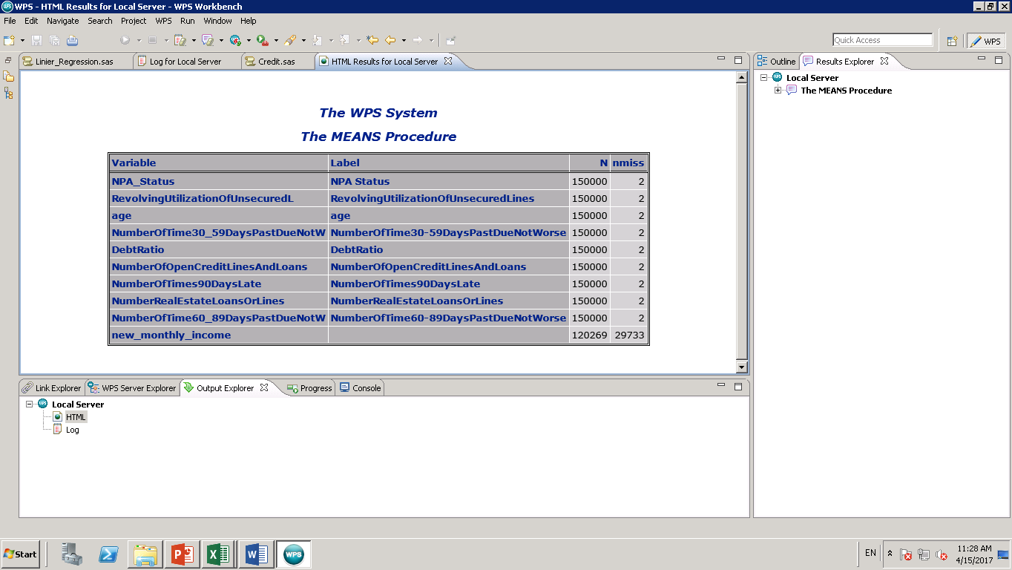
Data Exploration Check for the missing value and missing value treatment
/* Data Exploration*/
Proc means n nmiss data=Credit2.test;
run;
data Credit2.lreg1;
set Credit.test;
if missing(NPA_STATUS) then delete;
run;

Slide 7
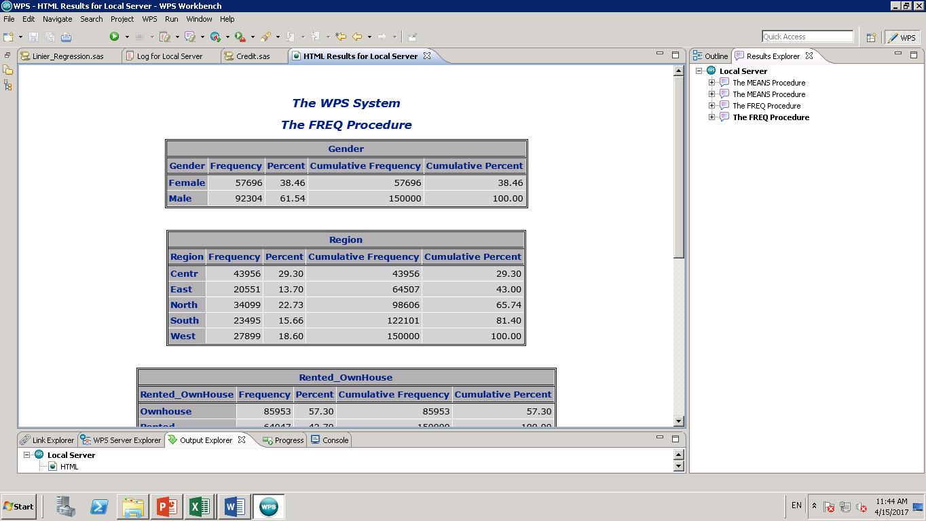
Data Preparation Checked and found that only 2 rows has this missing values, so I just deleted this observations.
proc means n nmiss data=Credit2.lreg1;
run;
For categorical variable I’m using Proc freq. (No missing value found)
Proc freq data=Credit2.lreg1;
table Gender Region Rented_OwnHouse Occupation Education;
run;

Slide 8
Data Preparation Data lreg2; set Credit.lreg1;
For Age
For Region
/*AGE*/
if age=0 then delete;
if age le 30 then age30=1;
else age30=0;
if 31 le age le 45 then age45=1;
else age45=0;
if 46 le age le 65 then age65=1;
else age65=0;
if 66 le age le 109 then age66=1;
else age66=0;
/* Region */
if Region='East' then east1=1;
else east1=0;
if Region='North' then north1=1;
else north1=0;
if Region='West' then west1=1;
else west1=0;
if region='South' then south1=1;
else south1=0;
if region='Centr' then centr1=1;
else centr1=0;

Slide 9
Data Preparation
For Education
Monthly Income & Oppucation
/* Monthly Income */
if new_monthly_income=. then new_monthly_income=0;
if new_monthly_income le 10000 then low_inc=1;
else low_inc=0;
if 10001 le new_monthly_income le 50000 then med_inc=1;
else med_inc=0;
if 50001 le new_monthly_income le 100000 then high_inc=1;
else high_inc=0;
if new_monthly_income> 100001 then very_high_inc=1;
else very_high_inc=0;
/* Occupation */
if Occupation= 'Self_Emp' then self_dummy=1;
else self_dummy=0;
if Occupation='Officer1' then officer1_dummy=1;
else officer1_dummy=0;
if Occupation='Officer2' then officer2_dummy=1;
else officer2_dummy=0;
if Occupation='Officer3' then officer3_dummy=1;
else officer3_dummy=0;
if Occupation='Non-offi' then nonoffi_dummy=1;
else nonoffi_dummy=0;
/* Education */
if Education='Matric' then matric_dummy=1;
else matric_dummy=0;
if Education= 'Graduate' then graduate_dummy=1;
else graduate_dummy=0;
if Education='Post-Grad' then pg_dummy=1;
else pg_dummy=0;
if Education='PhD' then phd_dummy=1;
else phd_dummy=0;
if Education='Professional' then prof_dummy=1;
else prof_dummy=0;
if Education='Matric' then new_education=1;
else if Education='Graduate' then new_education=2;
else if Education='Post-Grad' then new_education=3;
else if Education='PhD' then new_education=4;
else new_education=5;

Slide 10
Data Preparation
House ownership
Gender
/* House ownership status */
if Rented_OwnHouse= 'Ownhouse' then house1=1;
else house1=0;
/*Gende*/
if Gender='Male' then gender1=1;
else Gender1=0;

Slide 11
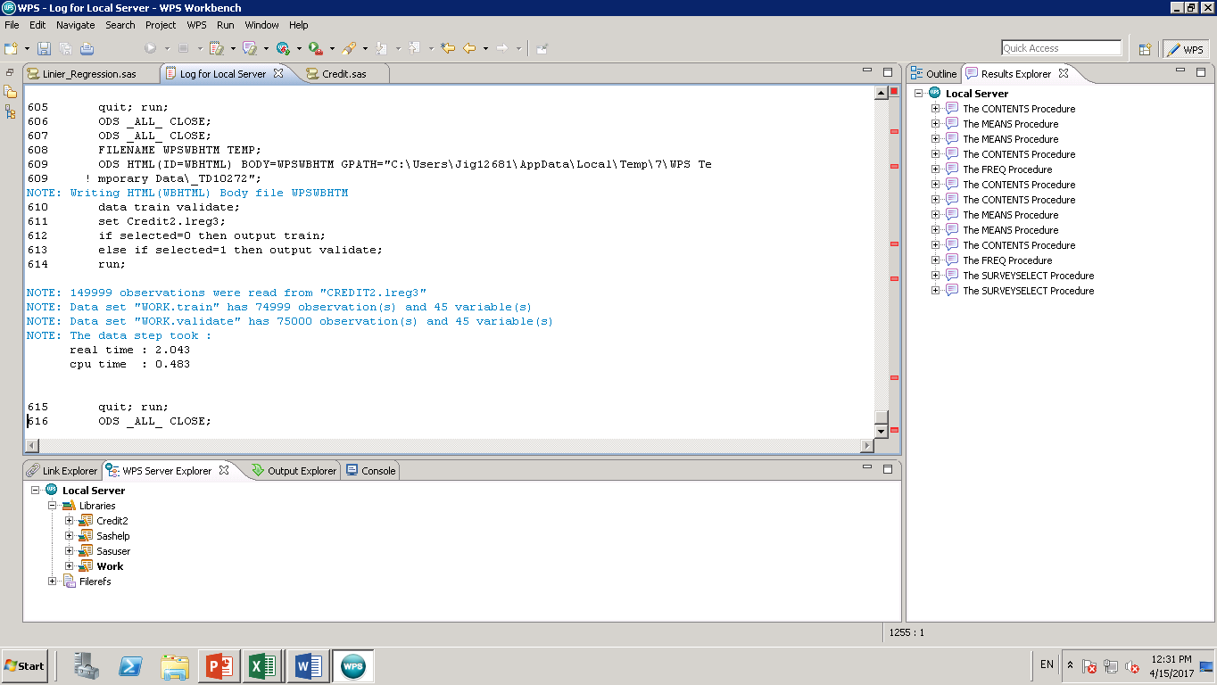
Splitting the data into training and Validation data set
Proc surveyselect data=lreg2
method= SRS out= lreg3 samprate=0.5 outall;
run;
data train validate;
set lreg3;
if selected=0 then output train;
else if selected=1 then output validate;
run;

Slide 12
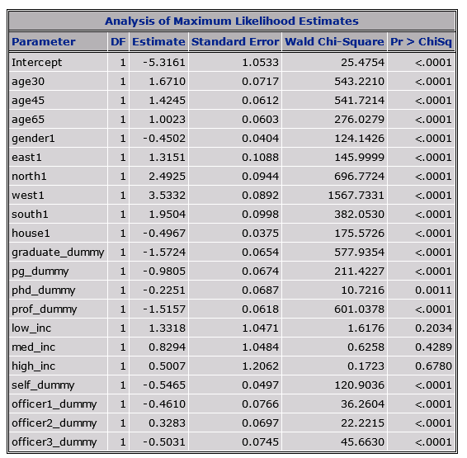
Logistic Regression Model
Proc Logistic data=train decending;
Model NPA_Status=age30 age45 age65 gender1 east1 north1 west1 south1 house1 graduate_dummy pg_dummy
phd_dummy prof_dummy low_inc med_inc high_inc self_dummy officer1_dummy officer2_dummy officer3_dummy/ctable lackfit;
run;
Income variables are not significant. We can either drop it or can check it as a whole whether income has any effect on log of odd ratio of NPA_Status or not.

Slide 13
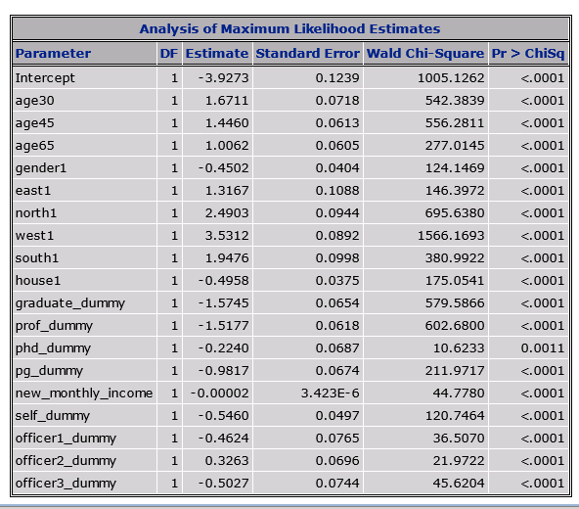
Regression model
Proc Logistic data=train decending outModel=lre4;
Model NPA_Status=age30 age45 age65 gender1 east1 north1 west1 south1 house1 graduate_dummy prof_dummy phd_dummy
pg_dummy new_monthly_income self_dummy officer1_dummy officer2_dummy officer3_dummy/ctable lackfit;
score out=lre5;
run;
Note: Here we see all the variable are significant. Now lets check the odd ratio estimates.

Slide 14
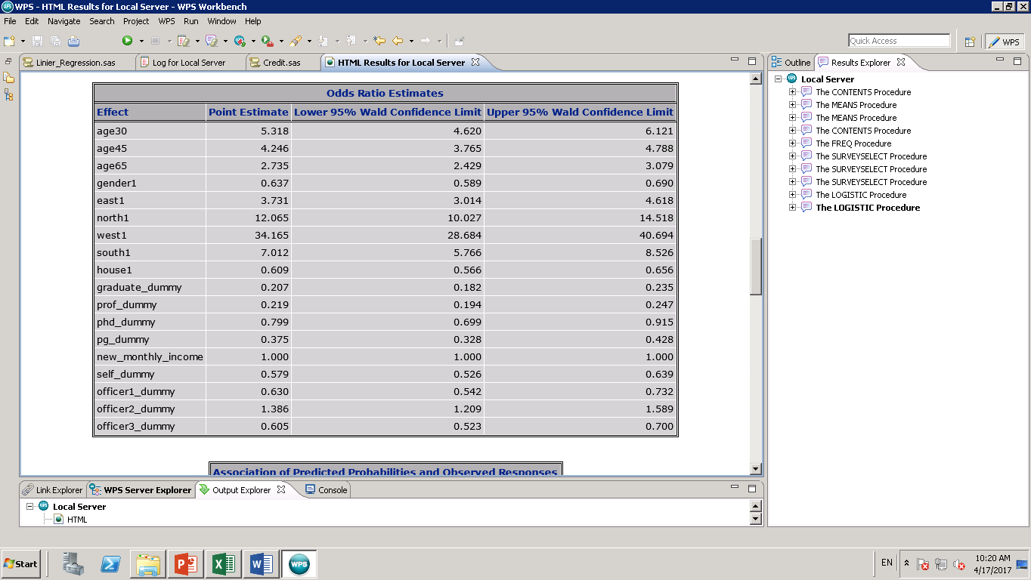
Odd Ratio Estimates (Confidence Interval)
From the table we can see that “1” is not content in the interval of any of the variable so we can conclude all the variable are significant.
Now we can check the how good the model is before finalizing the model.

Slide 15
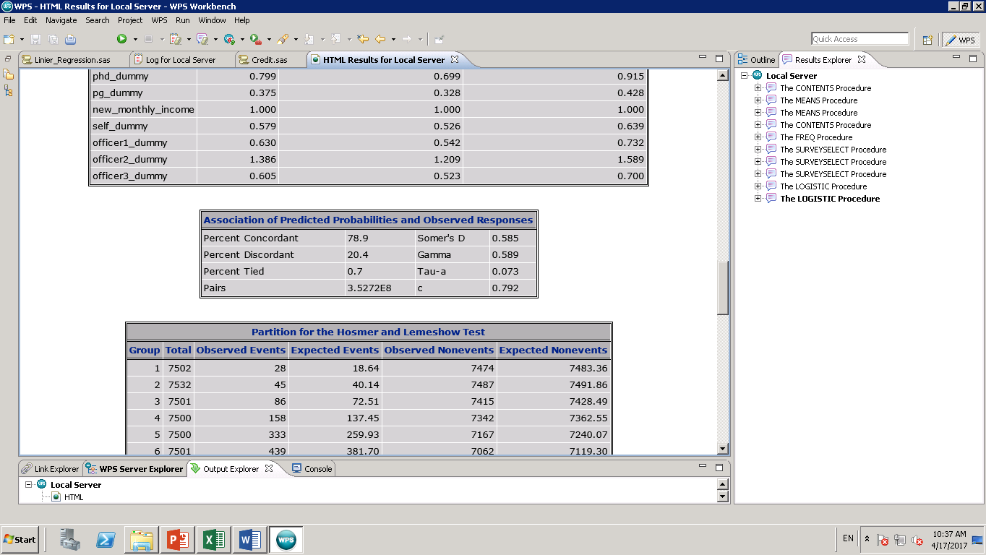
Concordance
In this model the concordance I s almost 79% so we can say it is a good model.
As per model 79% of time where there is actual high NPA_Status (“1”) the model also detected high NPA_Status relative to the low NPA_Status(“0”).
In the model C is 79.2% so the model gives 29.2% lift over a random model.

Slide 16
Gain/Lift Chart
To generate Gain/Lift chart we first generate the probability and divide the data in to 10 decile. Then exporting the data in to Excel.
proc rank data=lre5 out=decile groups=10 ties=mean;
var p_1;
ranks decile;
run;
proc sort data=decile;
by decending p_1;
run;
proc export data=decile outfile="Y:\pred.csv"
dbms=csv replace;
run;

Slide 17
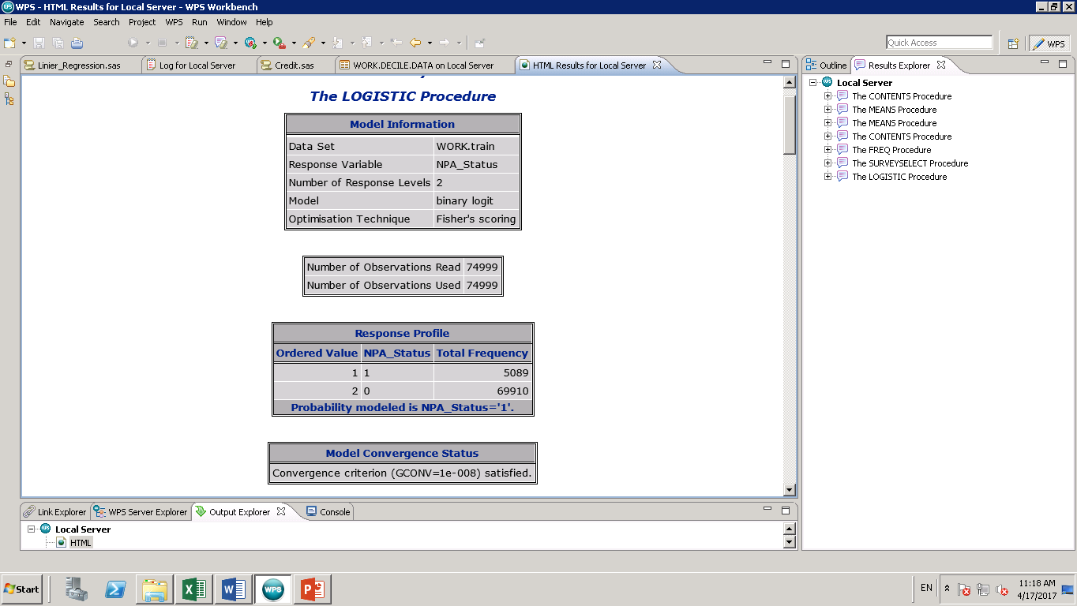
In our data High NPA_Status is for 5089 observations

Slide 18
In this chart we see more number of observed NPA “1” & lift is also very high, so it is a good model

Slide 19
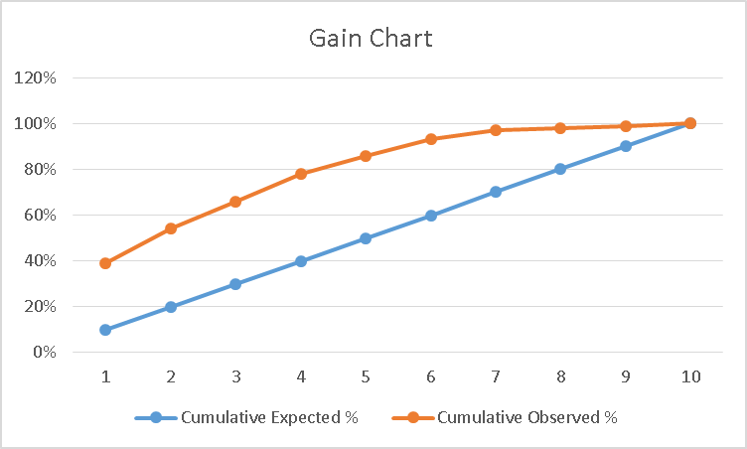
There is a high distance between Cumulative expected and Cumulative observed so this again proved that this is a good model

Slide 20
Model validation with our Credit scoring model
Proc Logistic data=train decending outModel=lre4;
Model NPA_Status=age30 age45 age65 gender1 east1 north1 west1 south1 house1 graduate_dummy prof_dummy phd_dummy
pg_dummy new_monthly_income self_dummy officer1_dummy officer2_dummy officer3_dummy/ctable lackfit;
score out=lre5;
run;
Proc Logistic data=Validate decending outModel=lre4;
Model NPA_Status=age30 age45 age65 gender1 east1 north1 west1 south1 house1 graduate_dummy prof_dummy phd_dummy
pg_dummy new_monthly_income self_dummy officer1_dummy officer2_dummy officer3_dummy/ctable lackfit;
score out=lre5;
run;

Slide 21
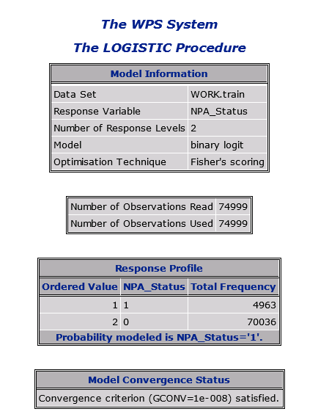
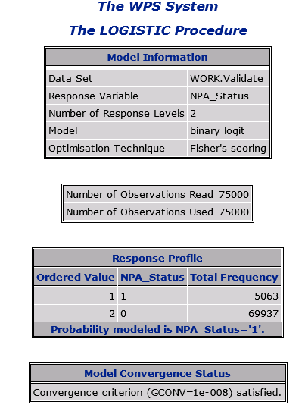
Training Data set
Validation Data Set

Slide 22
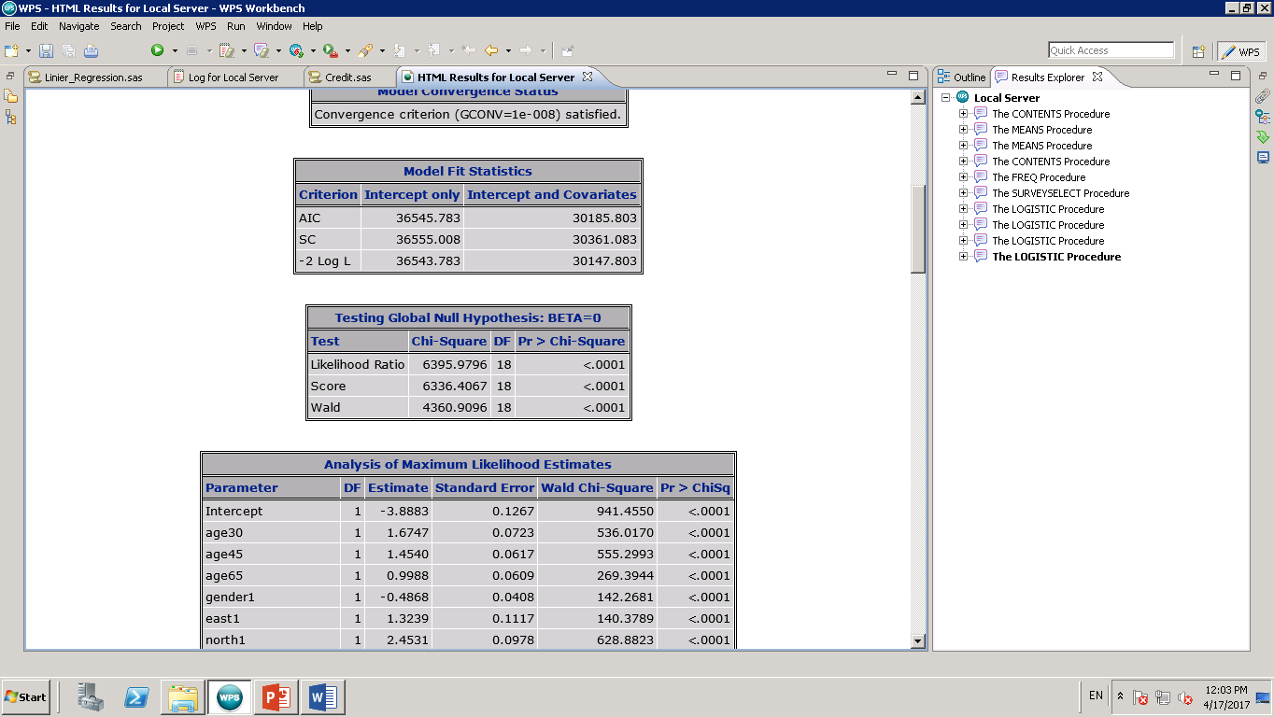
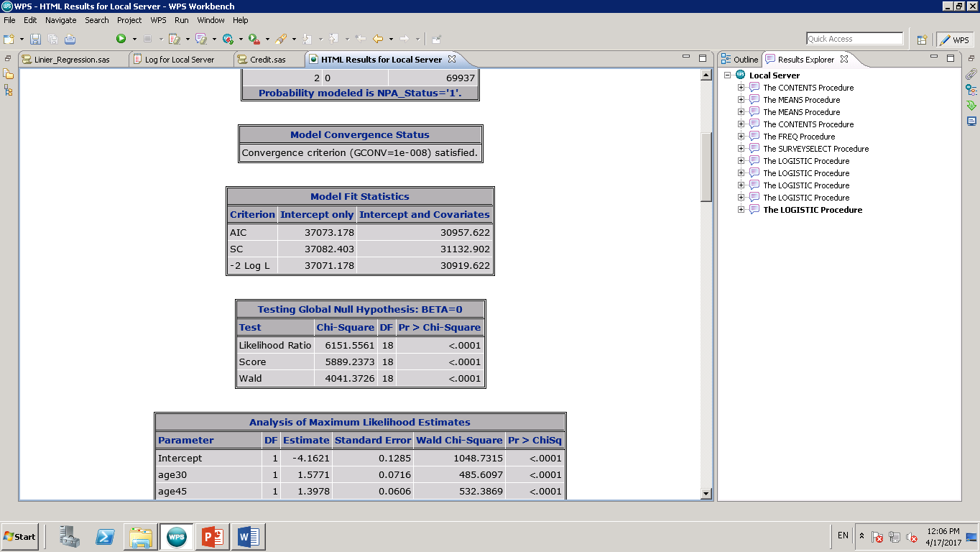
Training Data set
Validation Data Set

Slide 23
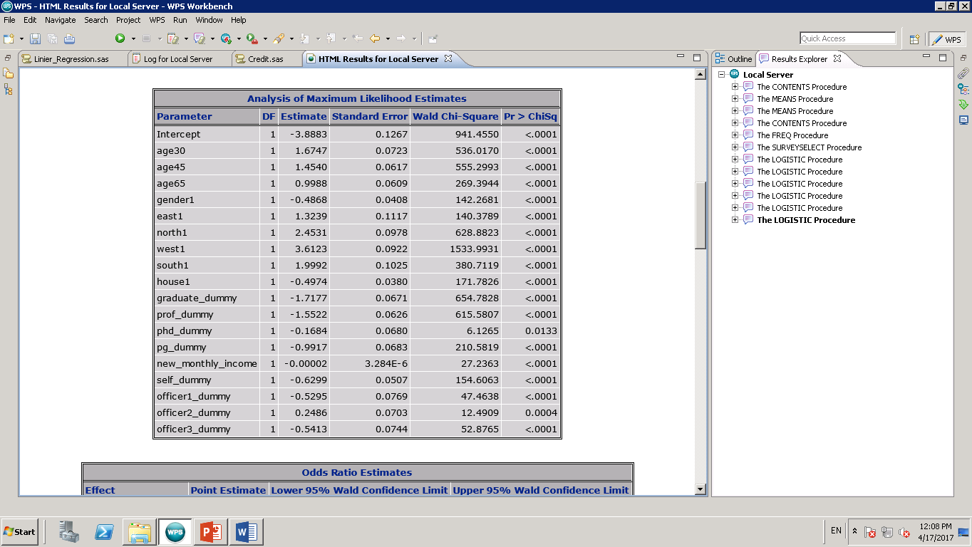
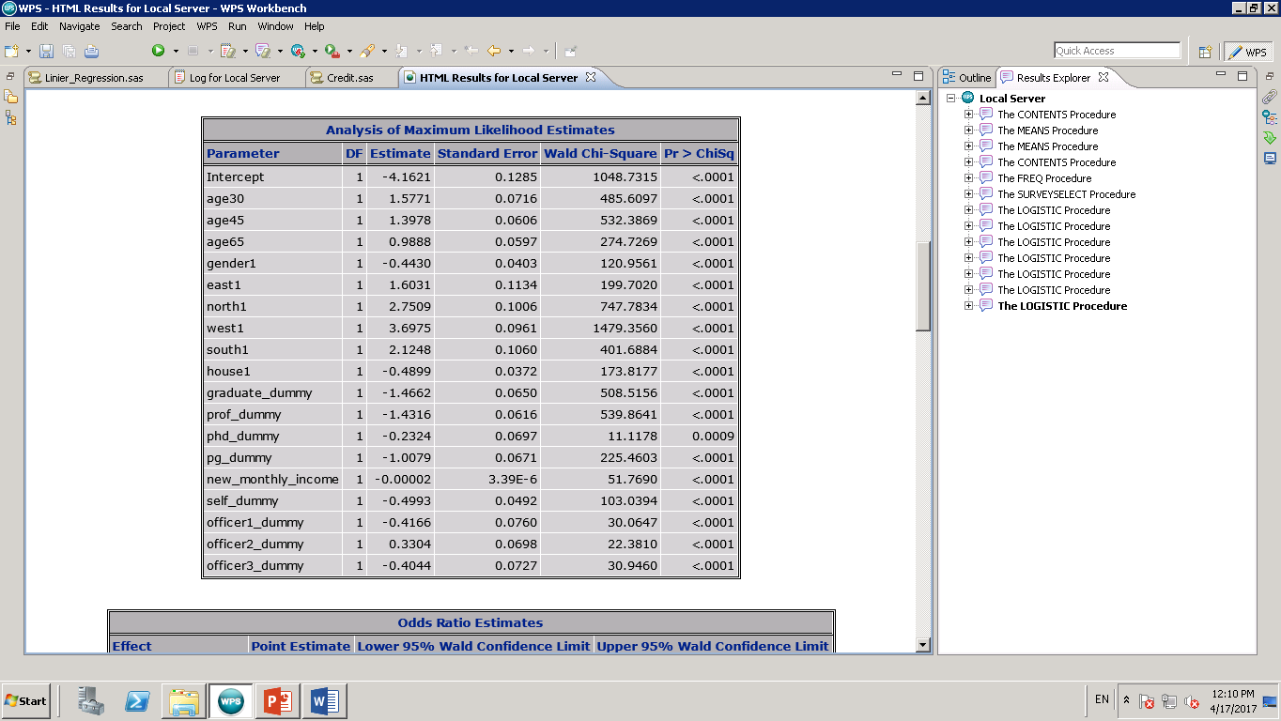
In both data set we are observing similar result for the coefficients
Training Data Set
Validation Data Set

Slide 24
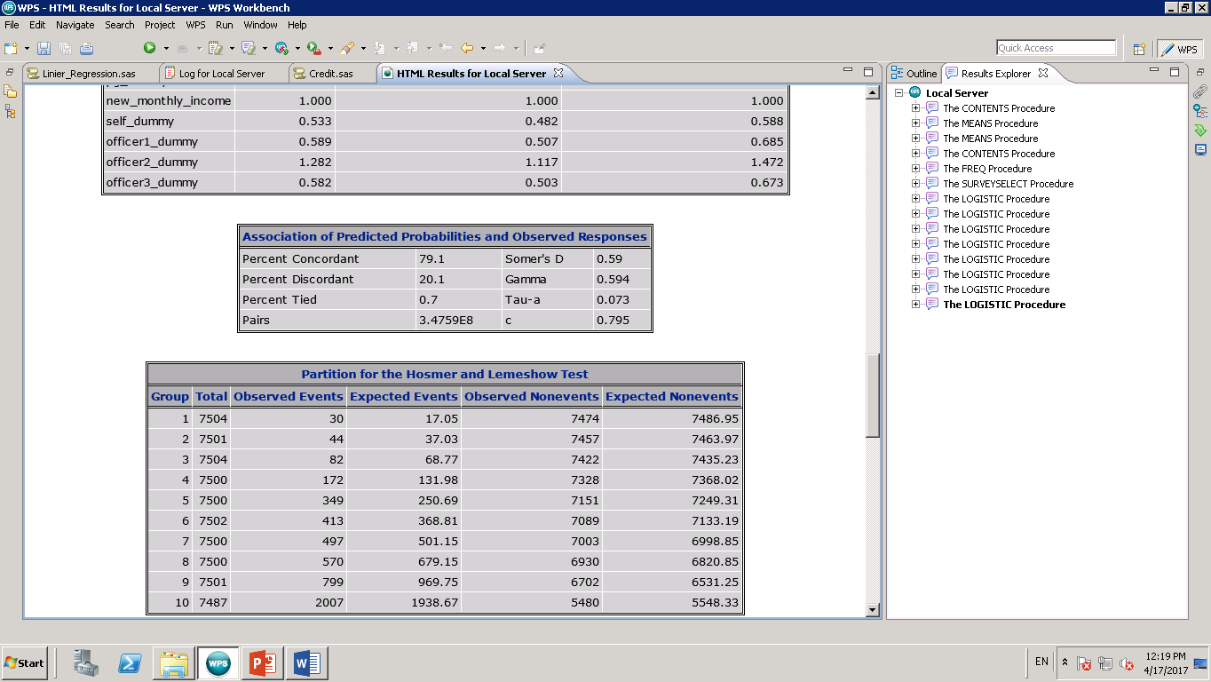
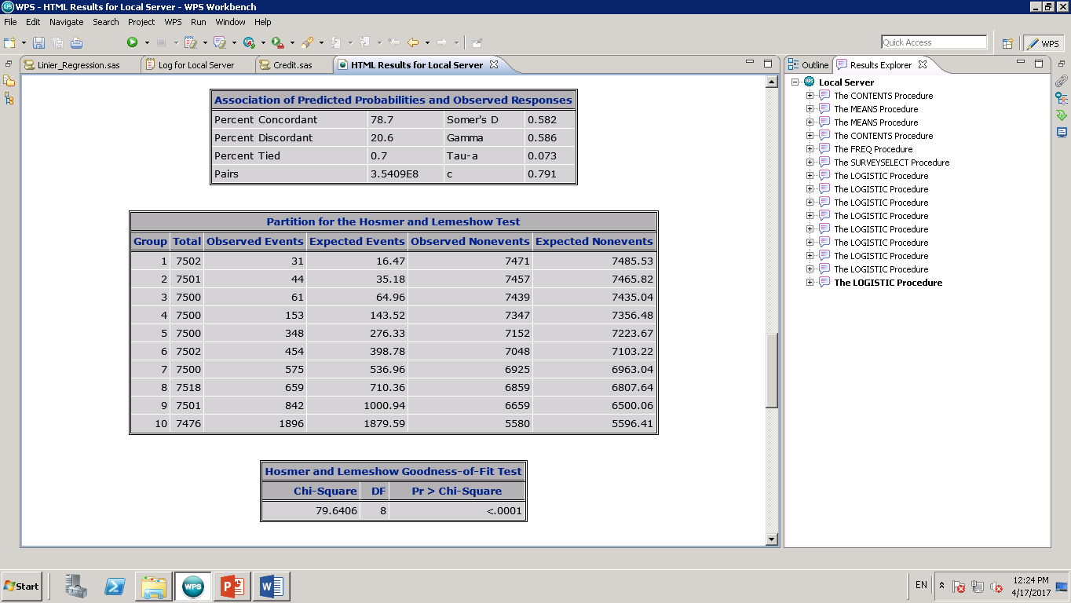
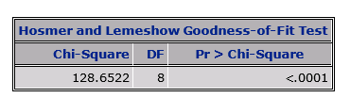

Here we also see similar result for concordance therefor our scoring model is validated
Training Data Set
Validation Data Set
This Model will perform very well on new data set

Slide 25
Thank You

